Slide 1
ITWS1100 Term Project
William Li, Eric Guo, Grace Peckham

Slide 2

Who are we?
A website designed for stock traders of all experience levels with low time commitment

Slide 3

Project Description
Website based resource for users to make an account based upon skill level
Gives users the opportunity to choose stocks
Collects Recent Data to Inform Users
Provides Helpful Statistics Based on Data Collected

Slide 4

Purpose
Educate users of different experience levels:
- Experienced users: have the ability to search their own stock to see what information will appear
- Inexperienced users: are given a list of well known, easy to understand stocks that are a good gateway into stock trading
- Allow those who aren’t able to fully dedicate their time to stock trading to stay educated

Slide 5
Design Decisions
ChatGPT Usage
Color Scheme
Similar Sites for Inspiration
Charts and Tables
Convey Information Fast and Efficient
Icons and Big Letters
For those who do not want to read a sentence

Slide 6
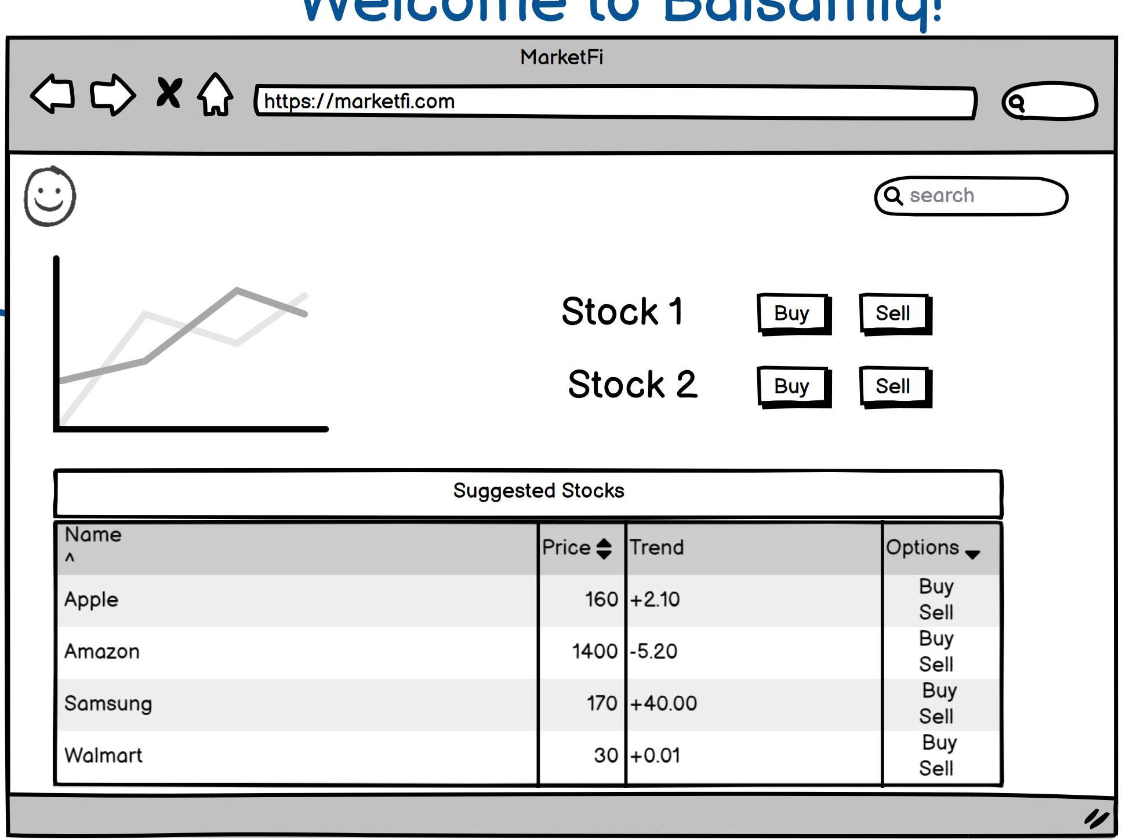
Balsamiq Mockup

Slide 7
Tools and Technology
Alpha Vantage: Stock Market API we used to get equity information and market news.
API returned information in JSON format
Used a combination of PHP and Jquery to generate our dynamic pages
Static pages were generated using just HTML and CSS
User Display Page uses Chart.js to create charts out of JSON

Slide 8
Development Process
Priorities
API Fetching
Data Display
Teaching Users
Design Nuances
Challenges
Unfamiliar Technology
Strange API Data
CSS Grievances
Merge Conflicts

Slide 9
DEMONSTRATION

Slide 10
Improvements
Flesh out Experienced User experience more
Implement user accounts
Implement trading algorithms to provide users with better recommendations
Move data from JSON file to Database

Slide 11
Questions?

